Slide 1
PHP and File I/O
CS/IT 490 WD, Fall 2013

Slide 2
Breakdown
JSON Format
CSV Format
Handling a file
Saving a file
Loading a file

Slide 3
JSON Format
JSON – JavaScript Object Notation is a data format that is essentially key-value pairs and arrays.
http://www.json.org/
Looks like this:
Key/Value pairs { “name” : “guybrush”, “age” : 25 }
Ordered Array: [ 9.99, 3.99, 2.99 ]

Slide 4
JSON Format
Like with PHP associative arrays, you can store JSON objects within JSON objects within JSON objects.
PHP can also easily parse JSON format files into arrays, with only a function call.
PHP can also convert an array to a JSON string, with only a function call.

Slide 5
CSV Format
CSV (Comma-Separated Value) is a file format that allows you to create spreadsheets, but in a simple text format.
Columns are separated by commas , (or some other delimiter), while rows are separated by new-lines.
PHP can also load in CSV files as an array

Slide 6
CSV Format
FIRST NAME,LAST NAME,PAY
Lee,Everett,$12.93
Shawn,Greene,$8.99
Brenda,St. John,$9.99

Slide 7
Handling a file
You can open a file for reading or writing with fopen.
You specify a flag to tell PHP whether this is a read, write, or append.
You use fread to read the file
You use filesize to get the size of the file
You use fclose to close the file once you're done.

Slide 8
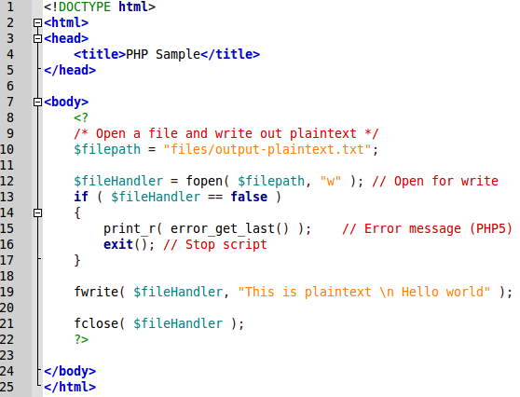
Saving a file
Let's save just a normal text file.

Slide 9
Saving a file
If we want to store a JSON or CSV file, first make an array:
The same File Open functions will be used, but we will write out the array contents differently...

Slide 10
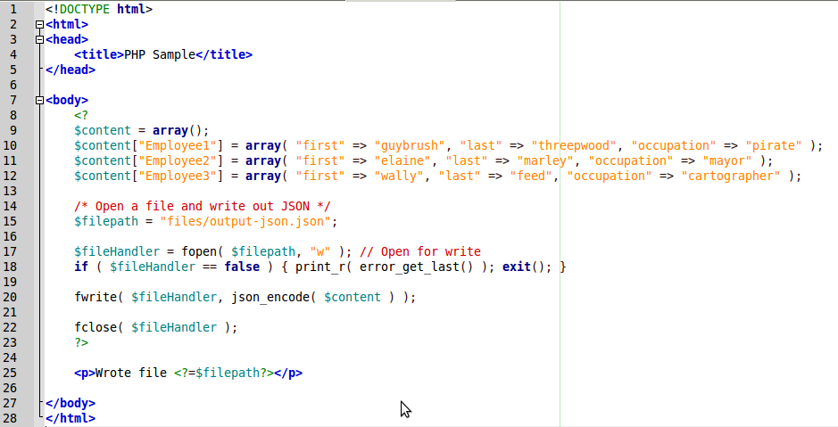
Saving a file
Saving a JSON file:

Slide 11
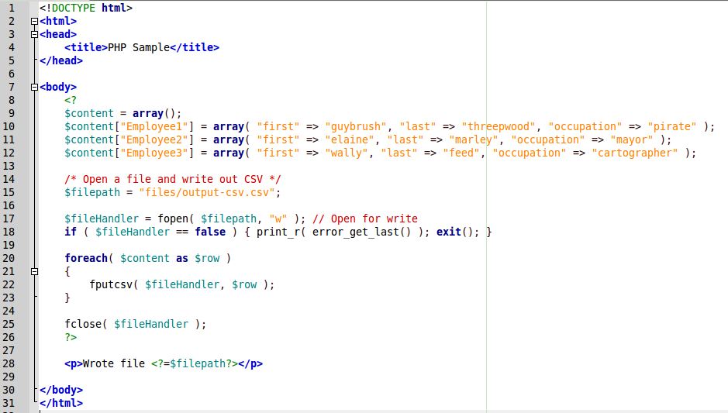
Saving a file
Saving a CSV file (We must iterate through all rows!)

Slide 12
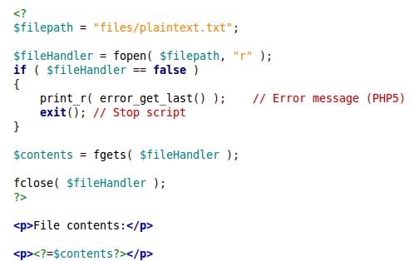
Loading a file
Reading a plaintext file

Slide 13
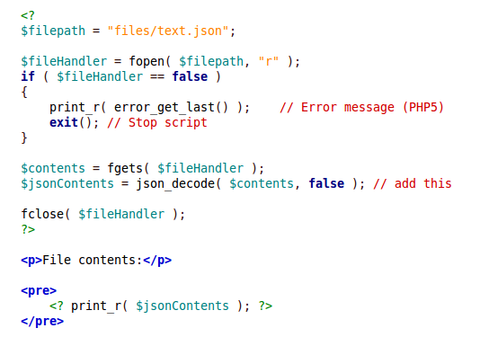
Loading a file
Reading a JSON file
Handy json_decode

Slide 14
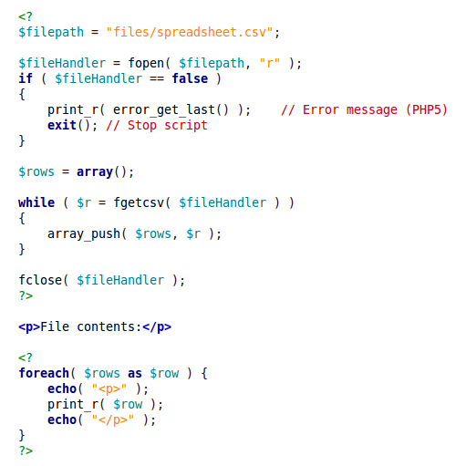
Loading a file
Reading a CSV file
Read one row at a time, while there are still rows to read!
Display each row, one row at a time!

Slide 15
Why File I/O?
Storing things that don't need a relational database.
Maybe relatively static content on a webpage
Easy and fast to read/write
Lightweight

Slide 16
Why File I/O?
What would be good for storing as simple text, JSON, or CSV?
What would be bad for storing as text, JSON, or CSV instead of in a database?
  Think of relationships!

Slide 17
References
-

